Slide 1
Introduction
Carbon Literacy is: -
“An awareness of the carbon dioxide costs and impacts of everyday activities and the ability and motivation to reduce emissions on an individual, community and organisational basis”.
T
Notes:
Carbon literacy aims specifically to empower people with the education necessary to reduce climate change.
It is

Slide 2
what Do we know?
Please choose a number between 1 and 3: 1 = ‘I know nothing’, 3 = ‘I know it all’!
How well do you understand climate change?
Would you be able to define ‘carbon sink’?
Do you believe your organisation can benefit by reducing climate change?
How motivated are you to reduce climate change?
Very Little
Very Much
Notes:
Standing – active, in motion
Why were doing this – CL is participative – not all about me talking at you

Slide 3
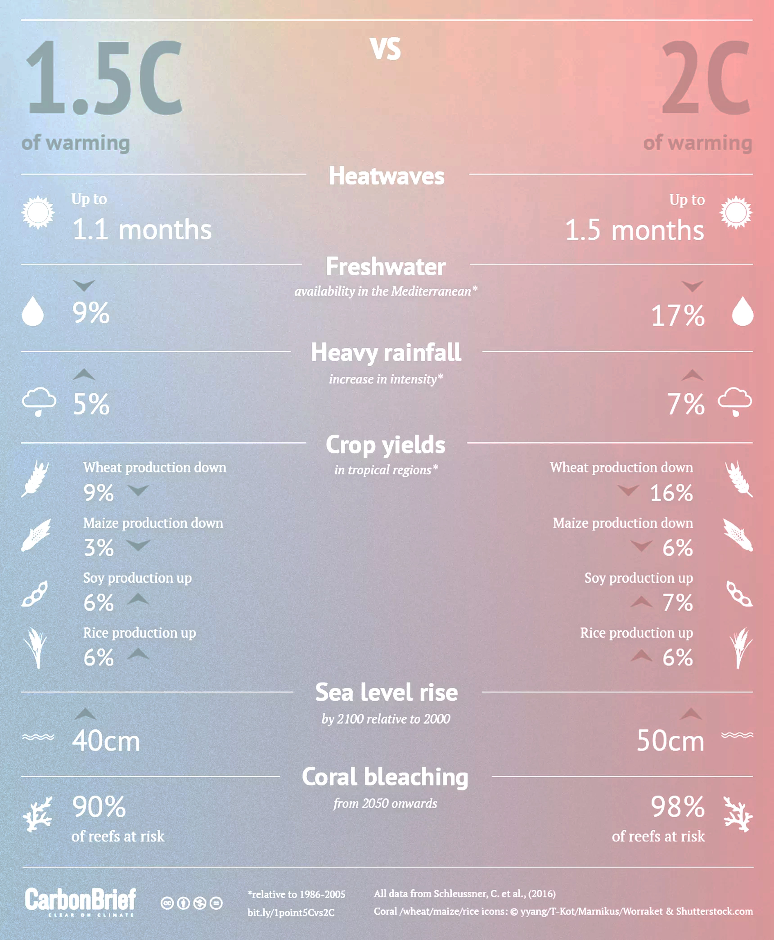
1.5 or 2 degrees?
We are nearing 1.5 degrees of warming now
Warming of more than 2 degrees will result in catastrophic climate change
Notes:
Carbon Dioxide equivalent gives us a level playing field to understad the effects of various activities

